Slide 1


Automatic Calibration of Multiplexed TES Systems
SRON Researcher:
Damian Audley
Supervisor:
Myroslav Kavatsyuk
Tom van Rees

Slide 2
Table of Contents
Introduction
Singular TES detector
Theory & Setup
Results
Multiplexed TES detectors
Theory & Setup
Results
Improvements

Slide 3
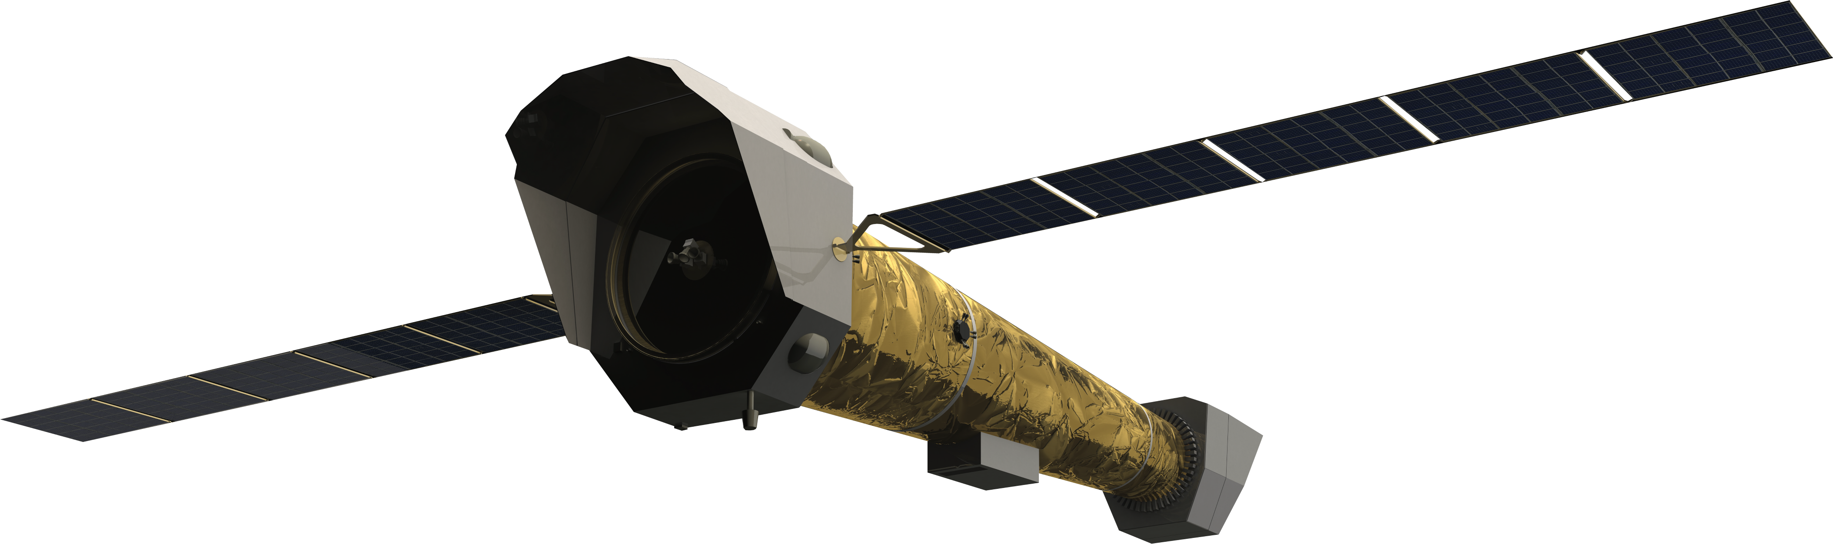
Introduction
TES: Transition Edge Sensor
Cryogenic Thermal Detectors -> Photons
ATHENA Mission
X-IFU -> X-ray
~3000 TES
Fig 1: Athena Telescope, from: https://www.ncbj.gov.pl/en/bp4/athena-advanced-telescope-high-energy-astrophysics, Accessed: 10/10/2021

Slide 4
Need of Research
Manual Analysis
Different Setup
Raw Data
Analysis
Export Parameters

Slide 5
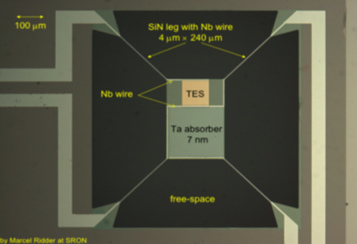
Transition Edge Sensor (TES)
T_{c} = ~ 0.1 K
Weakly linked to Heat Bath
Large amount of parameters
Fig 2: TES Bath. M. D. Audley et al., “Performance of a low-noise test facility for the safari TES bolometer arrays,” Journal of Low Temperature Physics, vol. 167, no. 3, pp. 208–213 (2012)

Slide 6
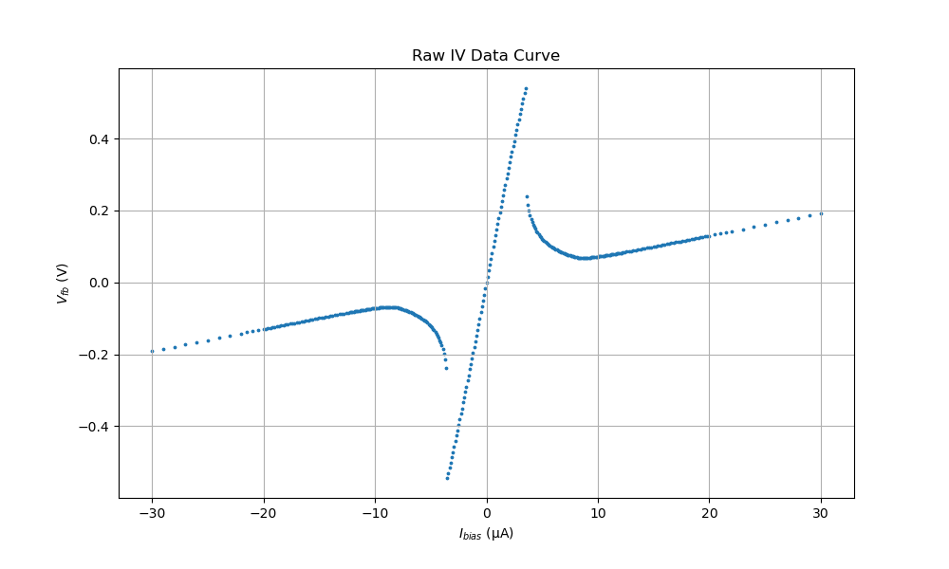
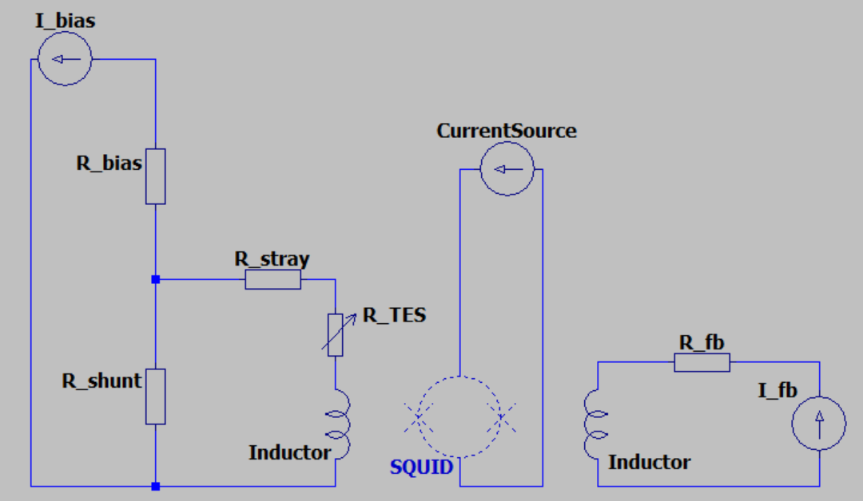
Transition Edge Sensor
SQUID: Superconducting QuantUm
Interference Device
Readout values: I_{bias} and V_{fb}
3 Regions: Ohmic, Transition, Superconducting
Further Analysis
Fig 3: Single TES Detector Electrical Setup
Fig 4: Raw IV Data

Slide 7
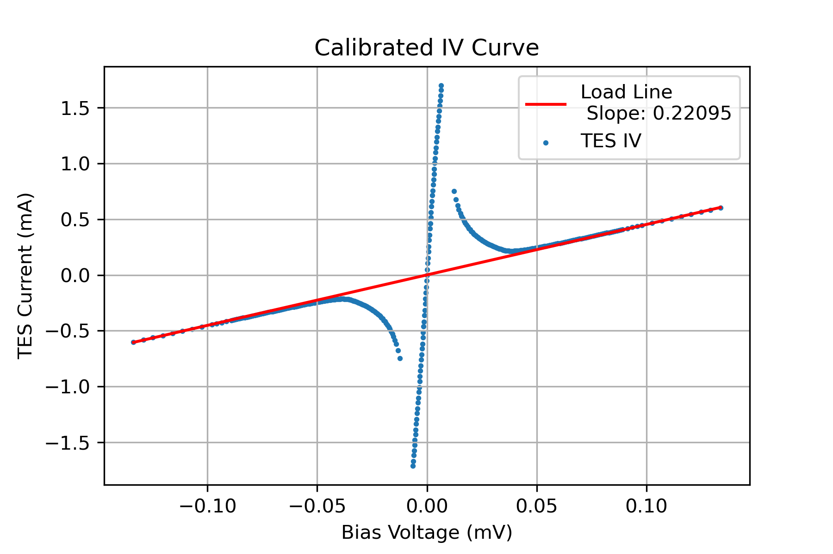
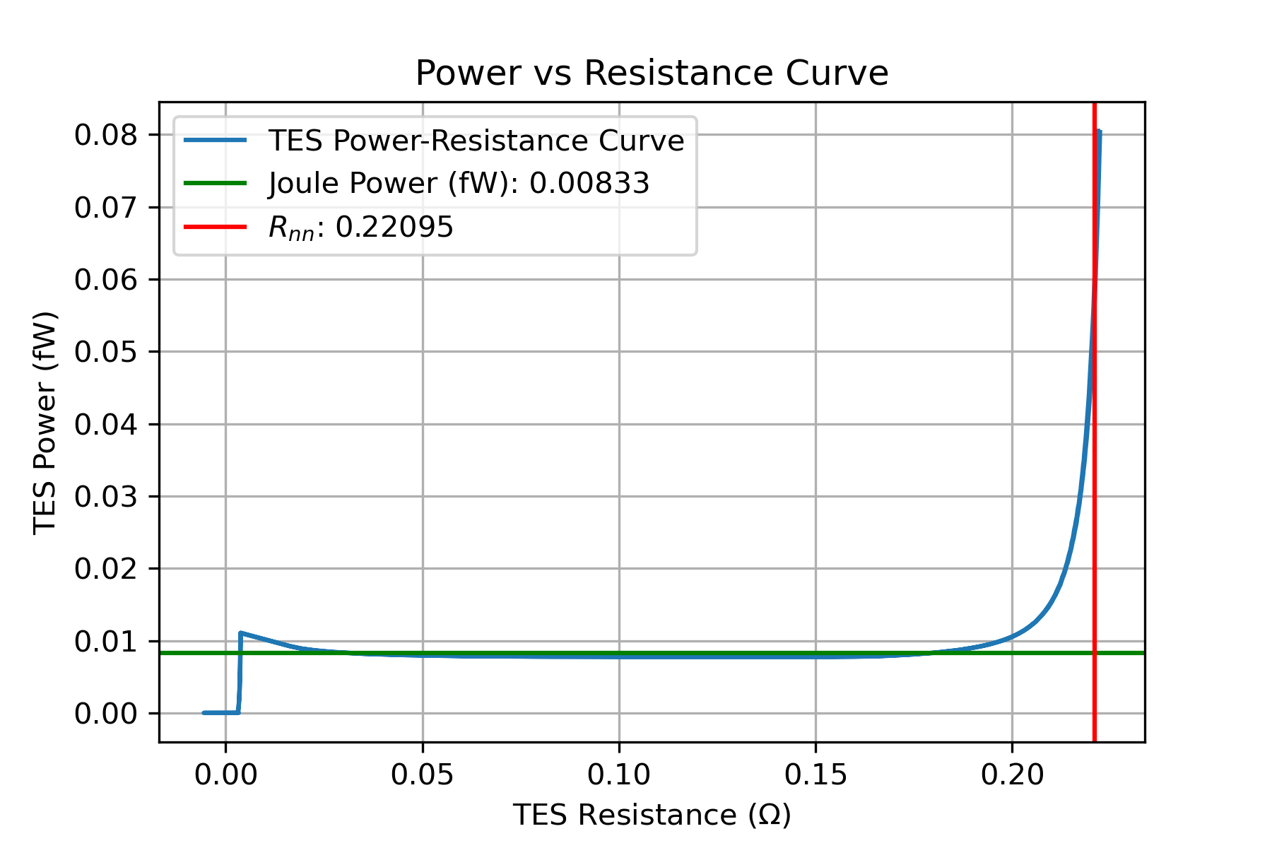
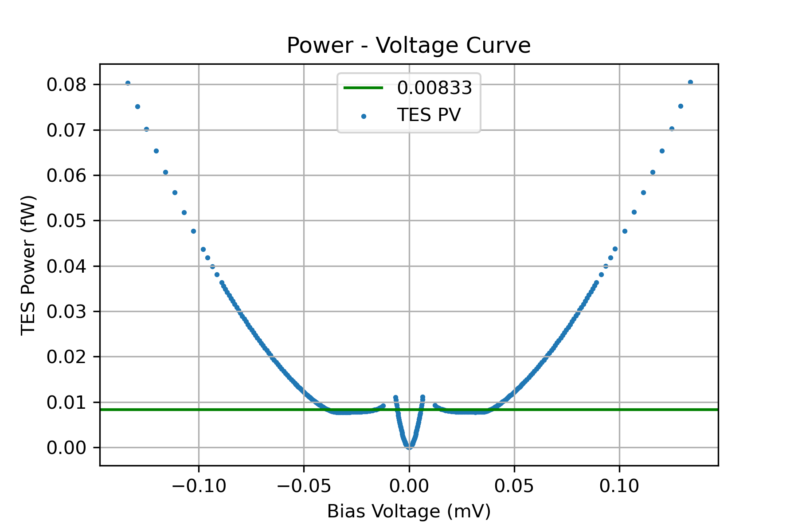
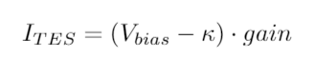
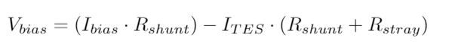
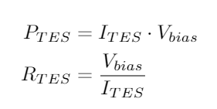
Power Plateaus
Fig 5: Power – Resistance Curve
Fig 6: IV Curve with loadline
Fig 7: Power – Resistance Curve

Slide 8
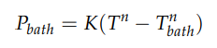
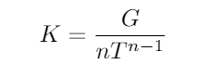
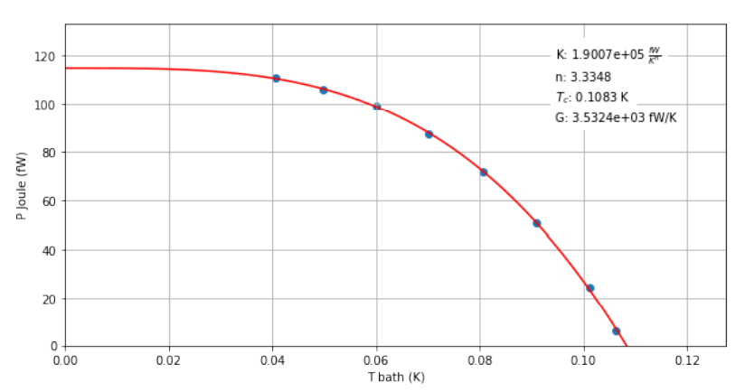
Final Parameters
Use T_{bath} and power values
Thermal Conductance G
Critical Temperature T_{c}
Fig 8: Thermal Conductance Plot. C. Blair, “Design of Software Routines for Automatic Calibration of Transition Edge Sensors”, University of Groningen (2019)

Slide 9
Results
2 Authors: Callum & Arnold
Raw Data
(.qdp, .xlsx, .dat)
NN Data Selection
Classifier
Single Sided Analysis
Export Parameters
Double Sided Analysis
IVcurve_double
Export Parameters
Callum
Reading datasets
Handling single datasets for inspection
Calculating parameters of individual datasets
Calculating parameters across multiple datasets
Arnold
Reading datasets
Convert to training data
Building Neural Network for identifying datasets
Applying NN on datasets for classification

Slide 10
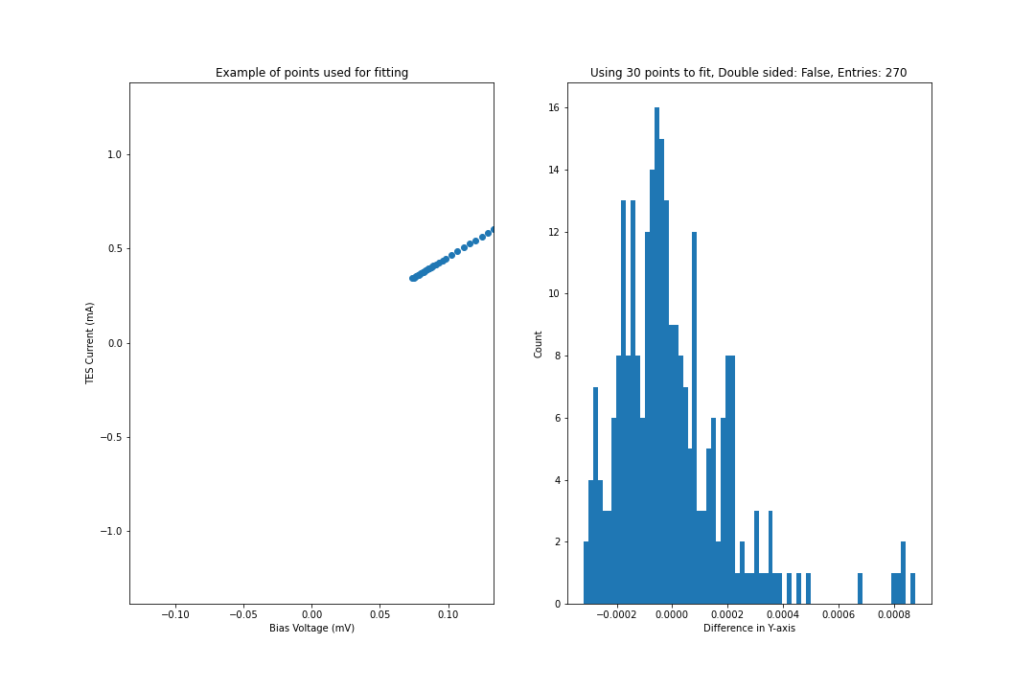
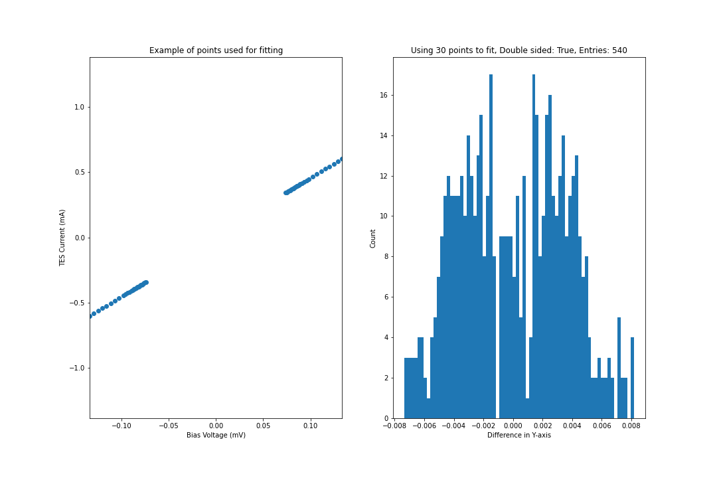
What have I done?
Combine Arnold’s & Callum’s Work
Look Into Fitting Method
Fig 10: IV curve with loadline
Fig 11: (Left) Example of points used for fitting. (Right) Distribution of distances of the points to the line
Fig 9: (Left) Example of points used for fitting. (Right) Distribution of distances of the points to the line

Slide 11
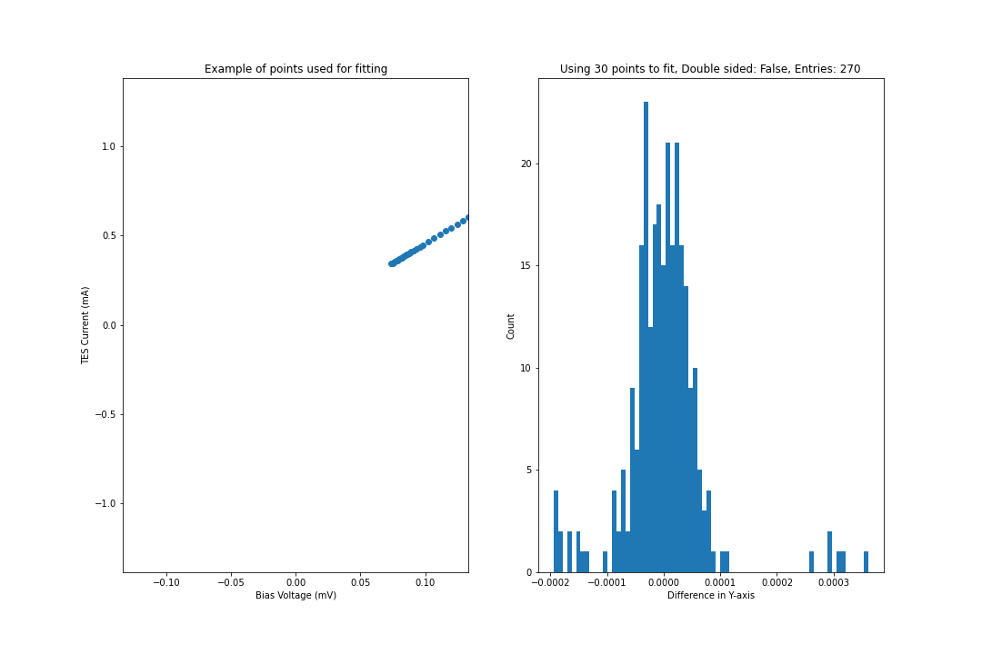

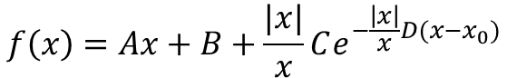
What have I done?
Exponential Distribution
Linear + Exponential Equation
$$f\left(x\right)=Ax+B+\frac{|x|}{x}Ce^{−\frac{\left|x\right|}{x}D(x−x_{0})}$$
Fig 12: (Left) Example of points used for fitting. (Right) Distribution of distances of the points to the line
Fig 13: (Left) Example of points used for fitting. (Right) Distribution of distances of the points to the line

Slide 12
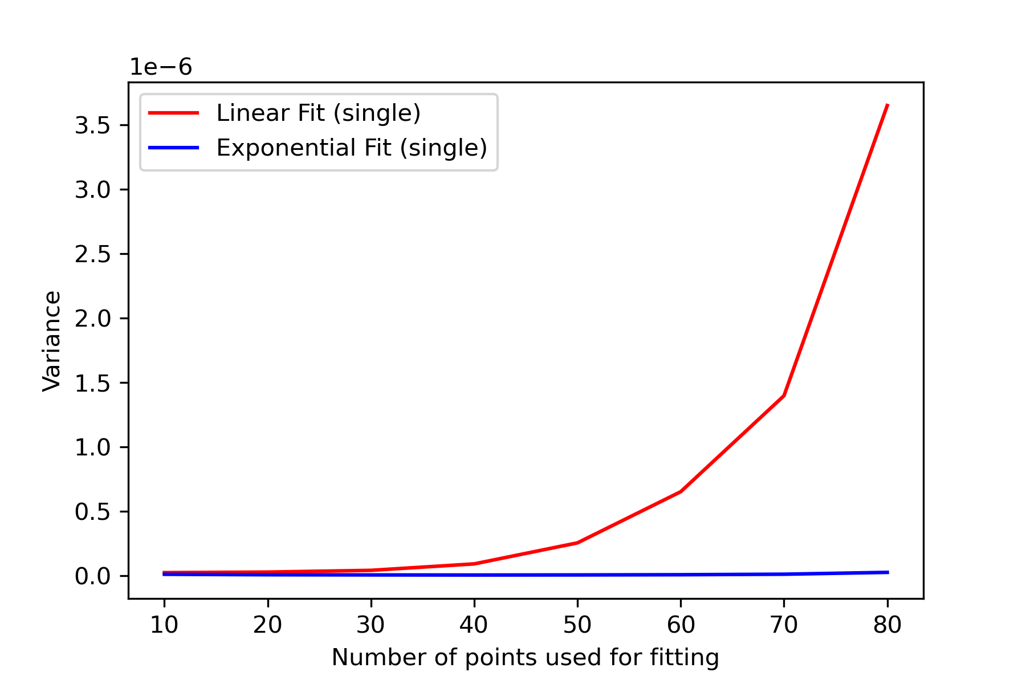
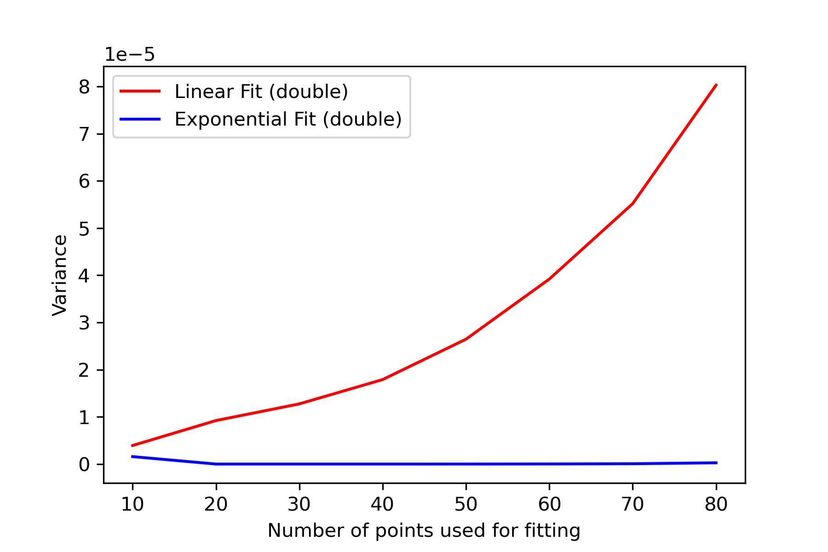
What have I done?
Fig 14: Variance of single sided fits for various number of fits
Fig 15: Variance of double sided fits for various number of fits

Slide 13
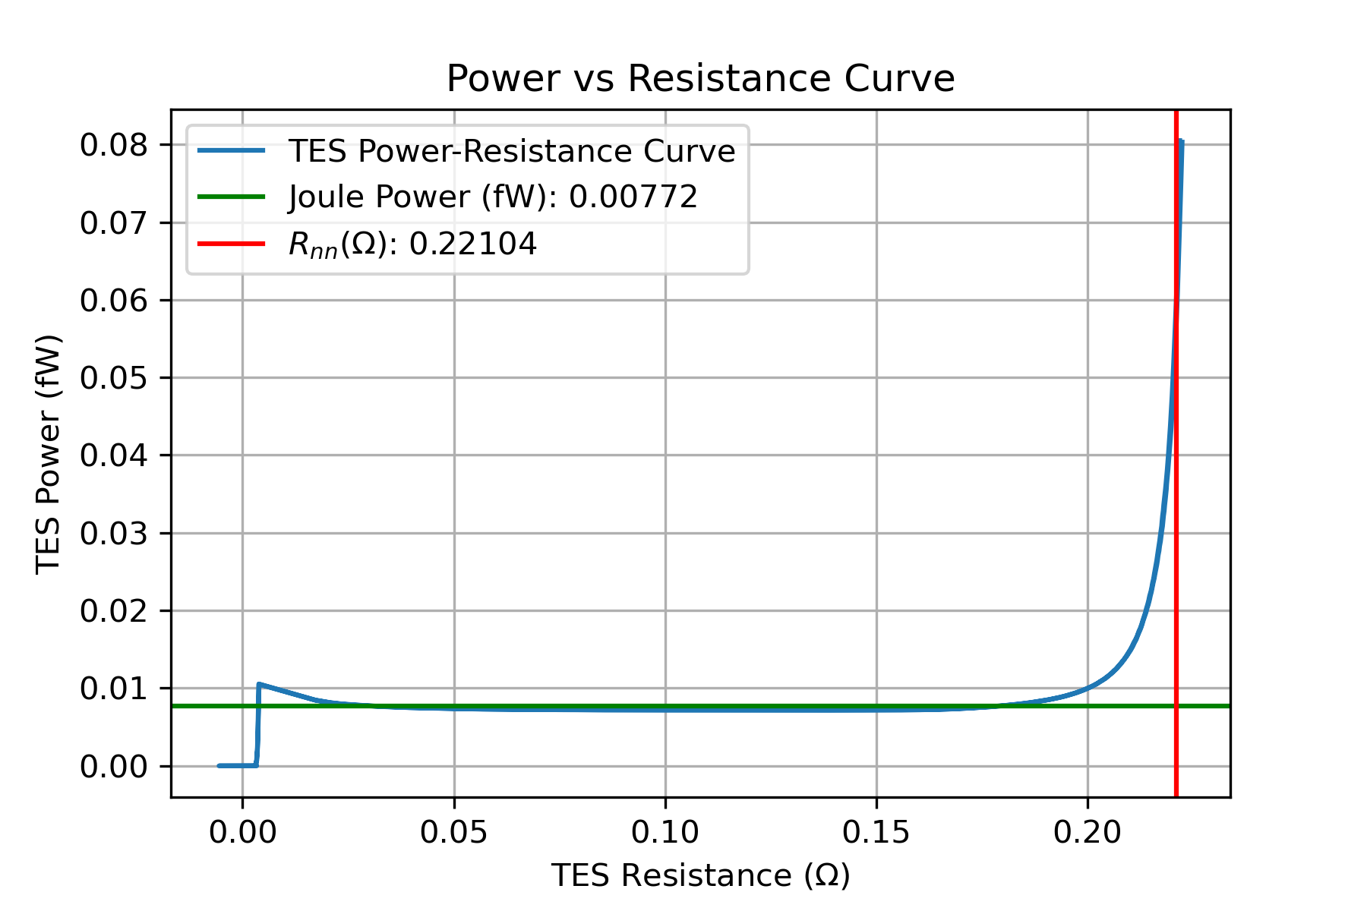
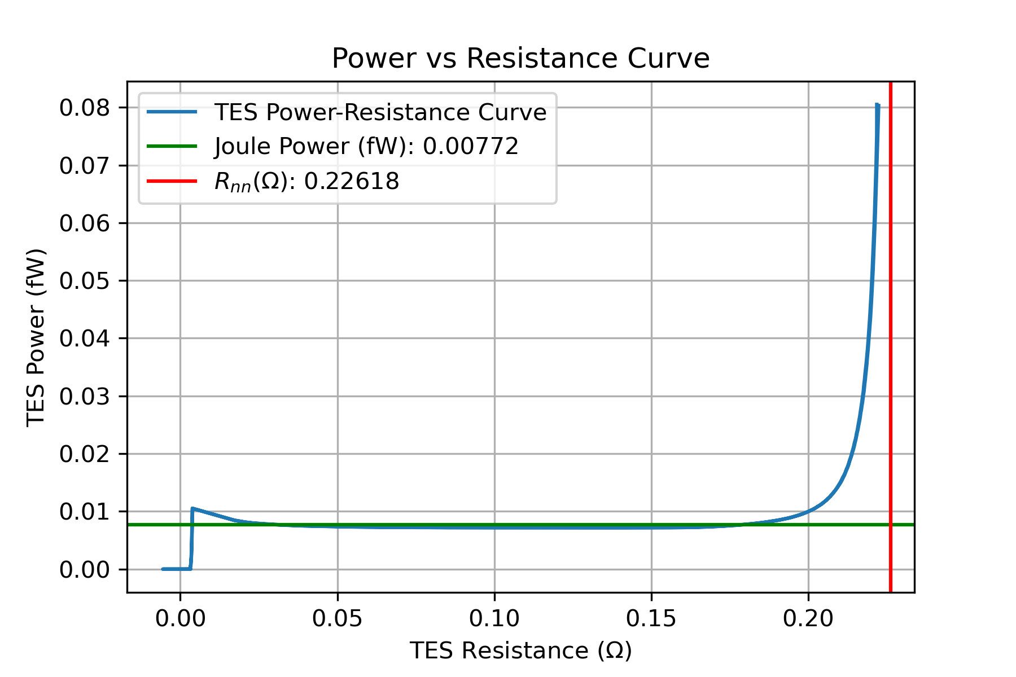
What have I done?
Fig 16: Power – Resistance curve using linear fitting method
Fig 17: Power – Resistance curve using exponential fitting method

Slide 14
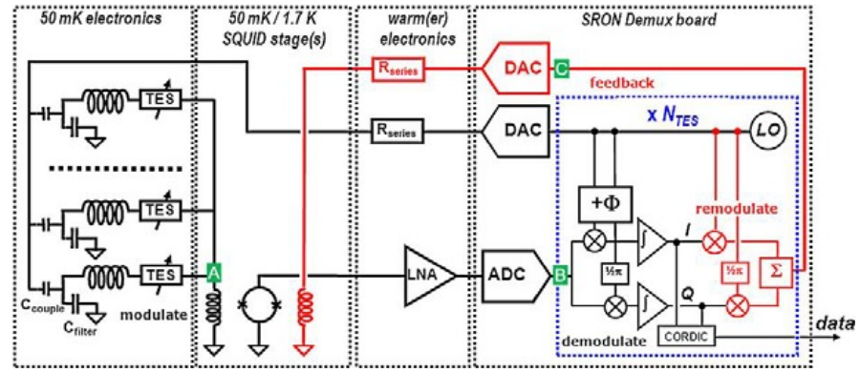
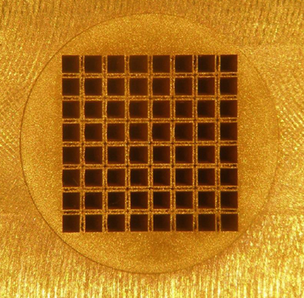
Frequency Domain Multiplexing
Chaining TES Together
LC Circuits -> Different Frequencies
1 – 3.8 MHz (16kHz)
AC-Voltage bias Source
Readout values: V_{fb} and V_{bias}
Fig 18: Multiplexed TES Sensors, R. A. Hijmering et al., “Readout of 176 pixel FDM system for SAFARI TES arrays”, Millimeter, Submillimeter and Far-Infrared Detectors and Instrumentation for Astronomy VIII. Vol: 9941 (2016)
6.72mm
Fig 19:TES Sensors Array

Slide 15
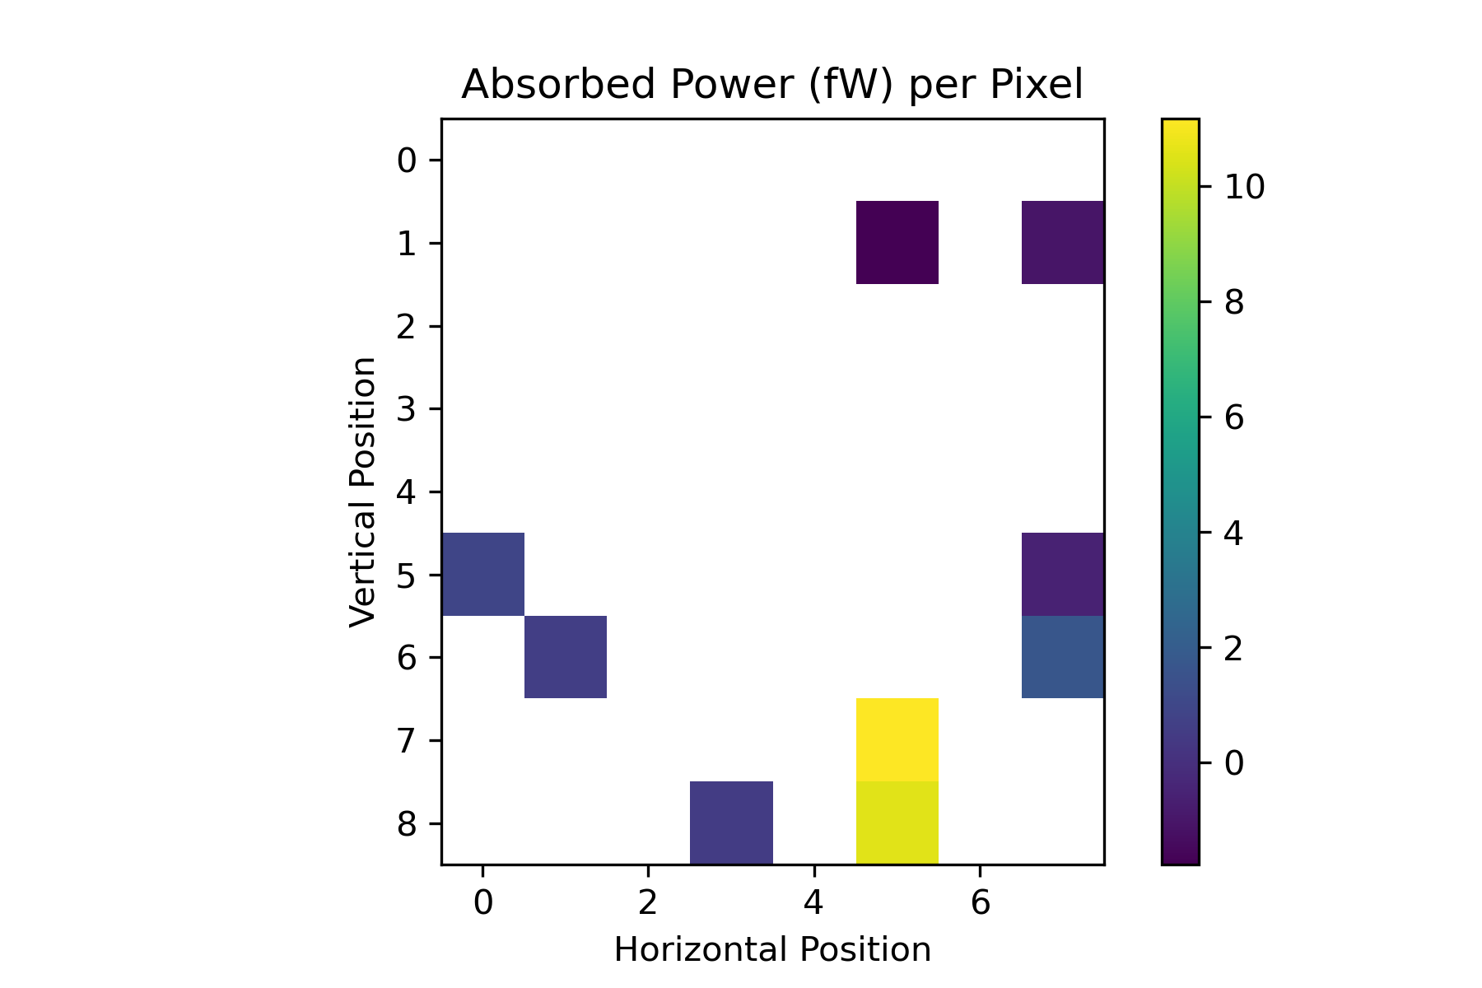
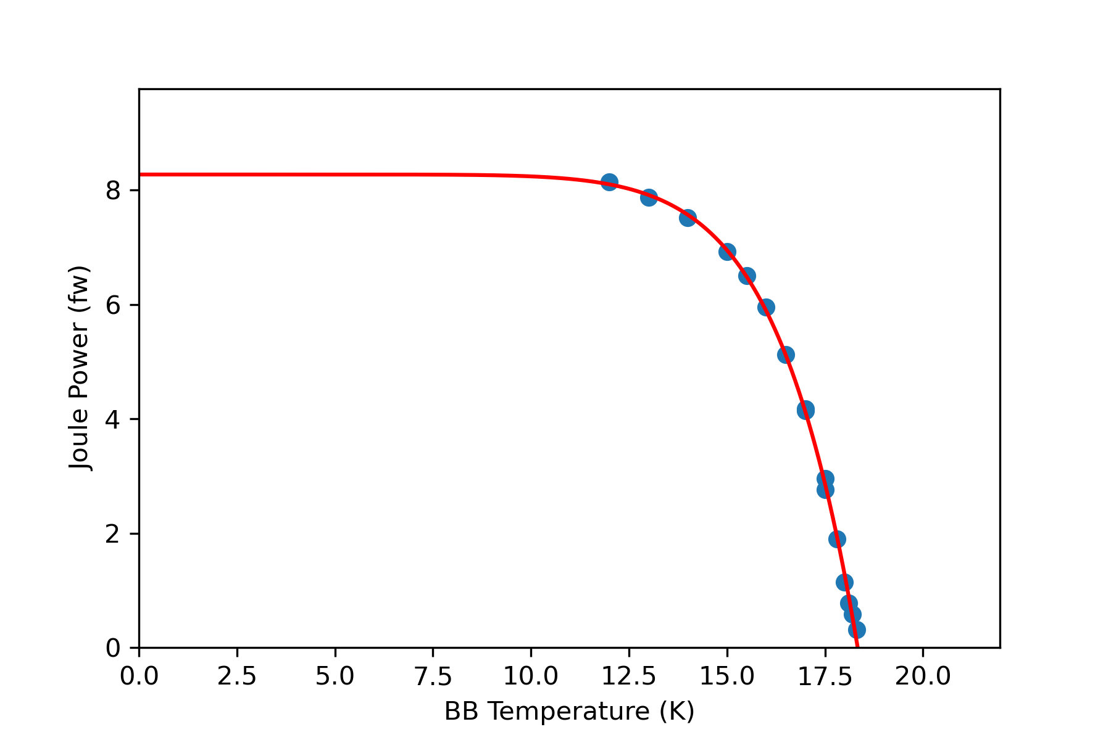
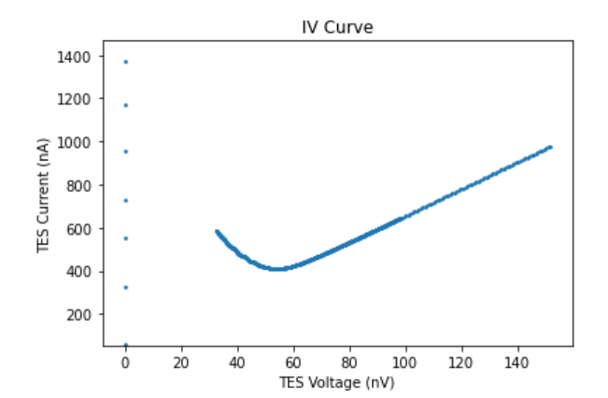
Results
Calibrated IV curve
TES placed in a grid
Absorbed power per pixel
Fig 21: Absorbed Joule Power per Pixel
Fig 22: Power – BB Temperature Plot
Fig 20: Single Sided IV Curve

Slide 16
Summary
New Fitting Method
Extended Analysis
Time Saving
https://github.com/TomR21/TES-Analysis-Program
Raw Data
(.qdp, .xlsx, .dat)
NN Data Selection
Classifier
Single Sided Analysis
Ivcurve_single
Export Parameters
Double Sided Analysis
IVcurve_double
Export Parameters

Slide 17
Improvements
FDM System:
- Simultaneous Pixel Measurements
- Better Understanding
Software:
- Generalizable Data Reading
- Error Estimation
- Josephson Inductance

Slide 18
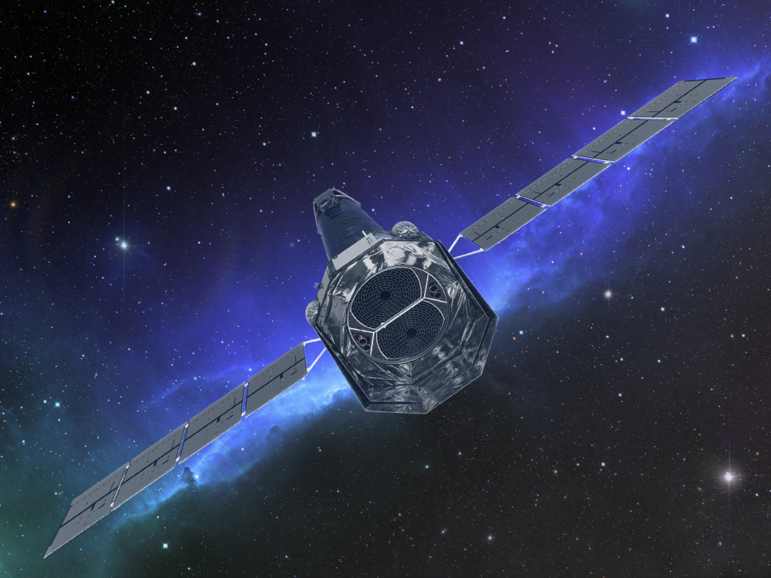
Thanks for listening!
https://github.com/TomR21/TES-Analysis-Program

